Slide 1
Neural Network
Nuran Tarlan | nuran.terlan@mail.ru

Slide 2
TABLE OF CONTENTS
01
02
03
What are neural networks?
How do neural networks work?
Types of neural networks?
04
05
06
Neural Networks vs. Deep Learning
History & Applications of NN
Pros & Cons of usages of NN

Slide 3
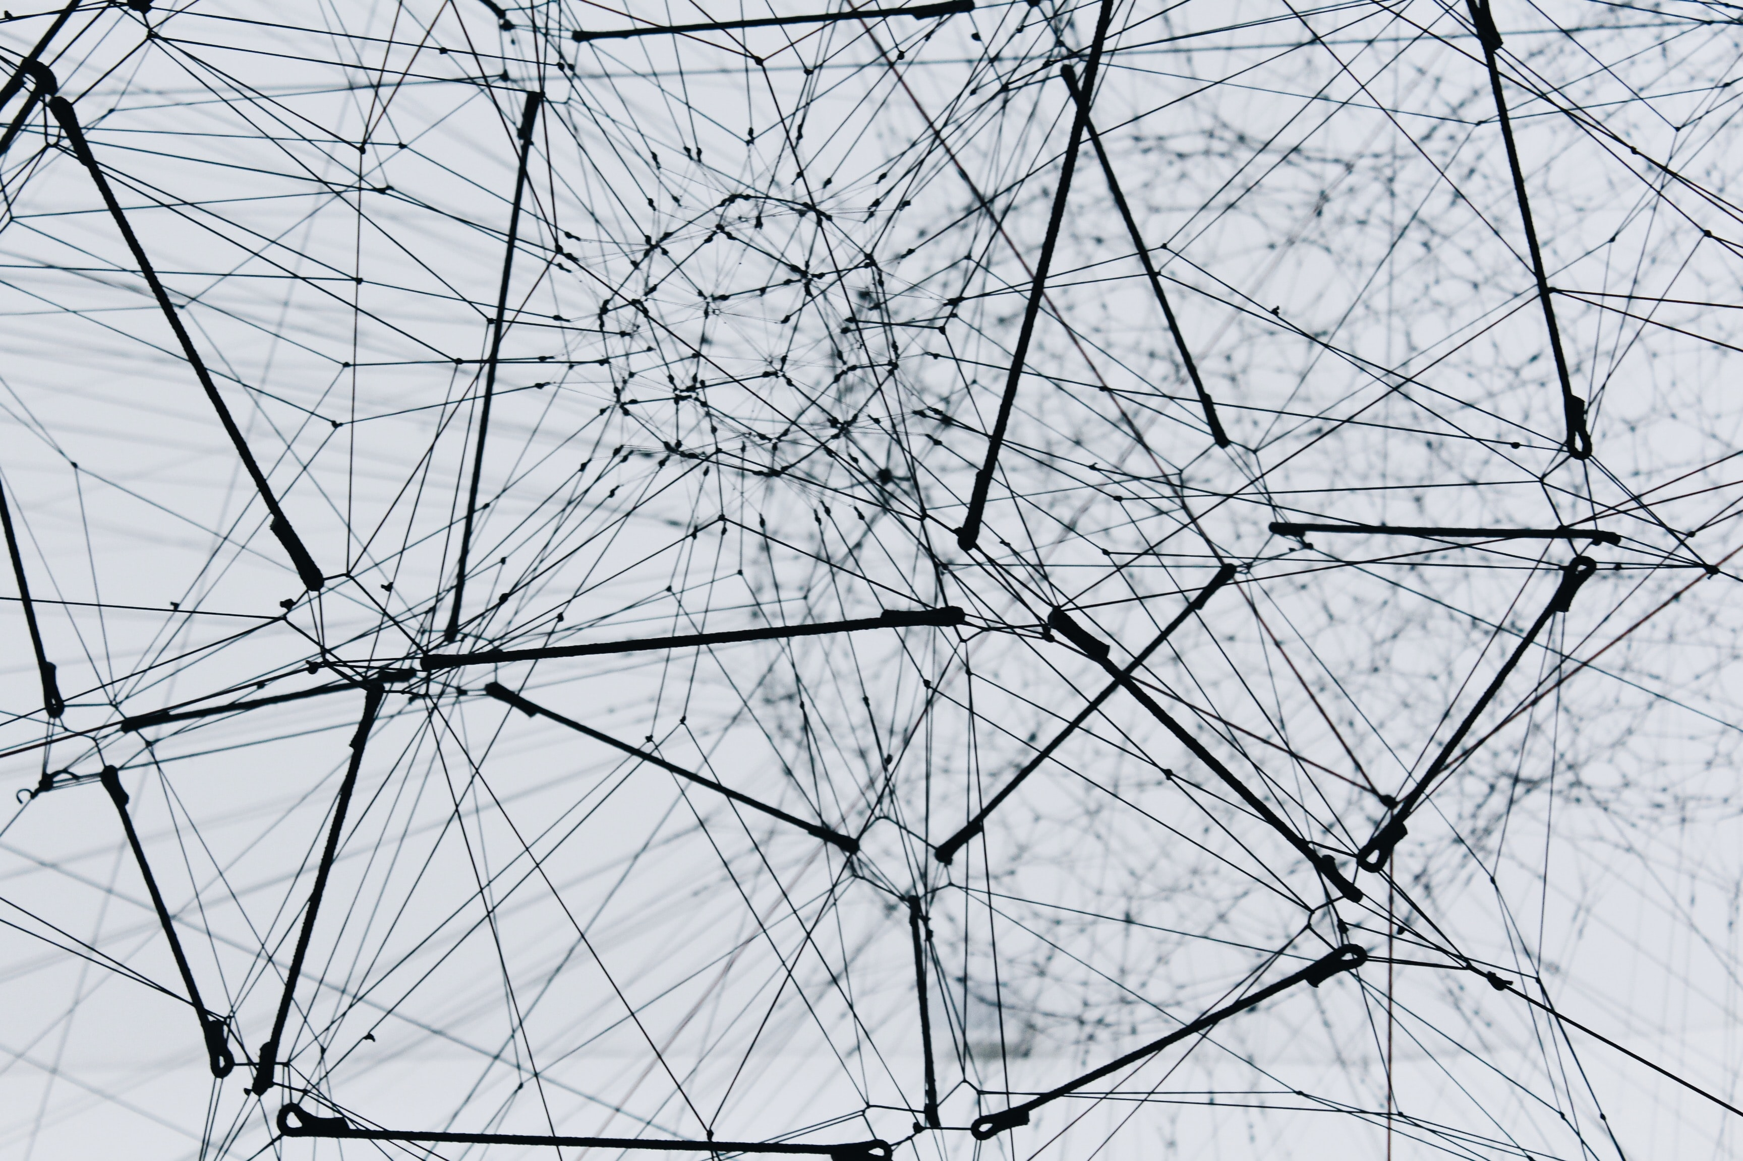
Brief ref.
Neural networks reflect the behavior of the human brain, allowing computer programs to recognize patterns and solve common problems in the fields of AI, machine learning, and deep learning.

Slide 4
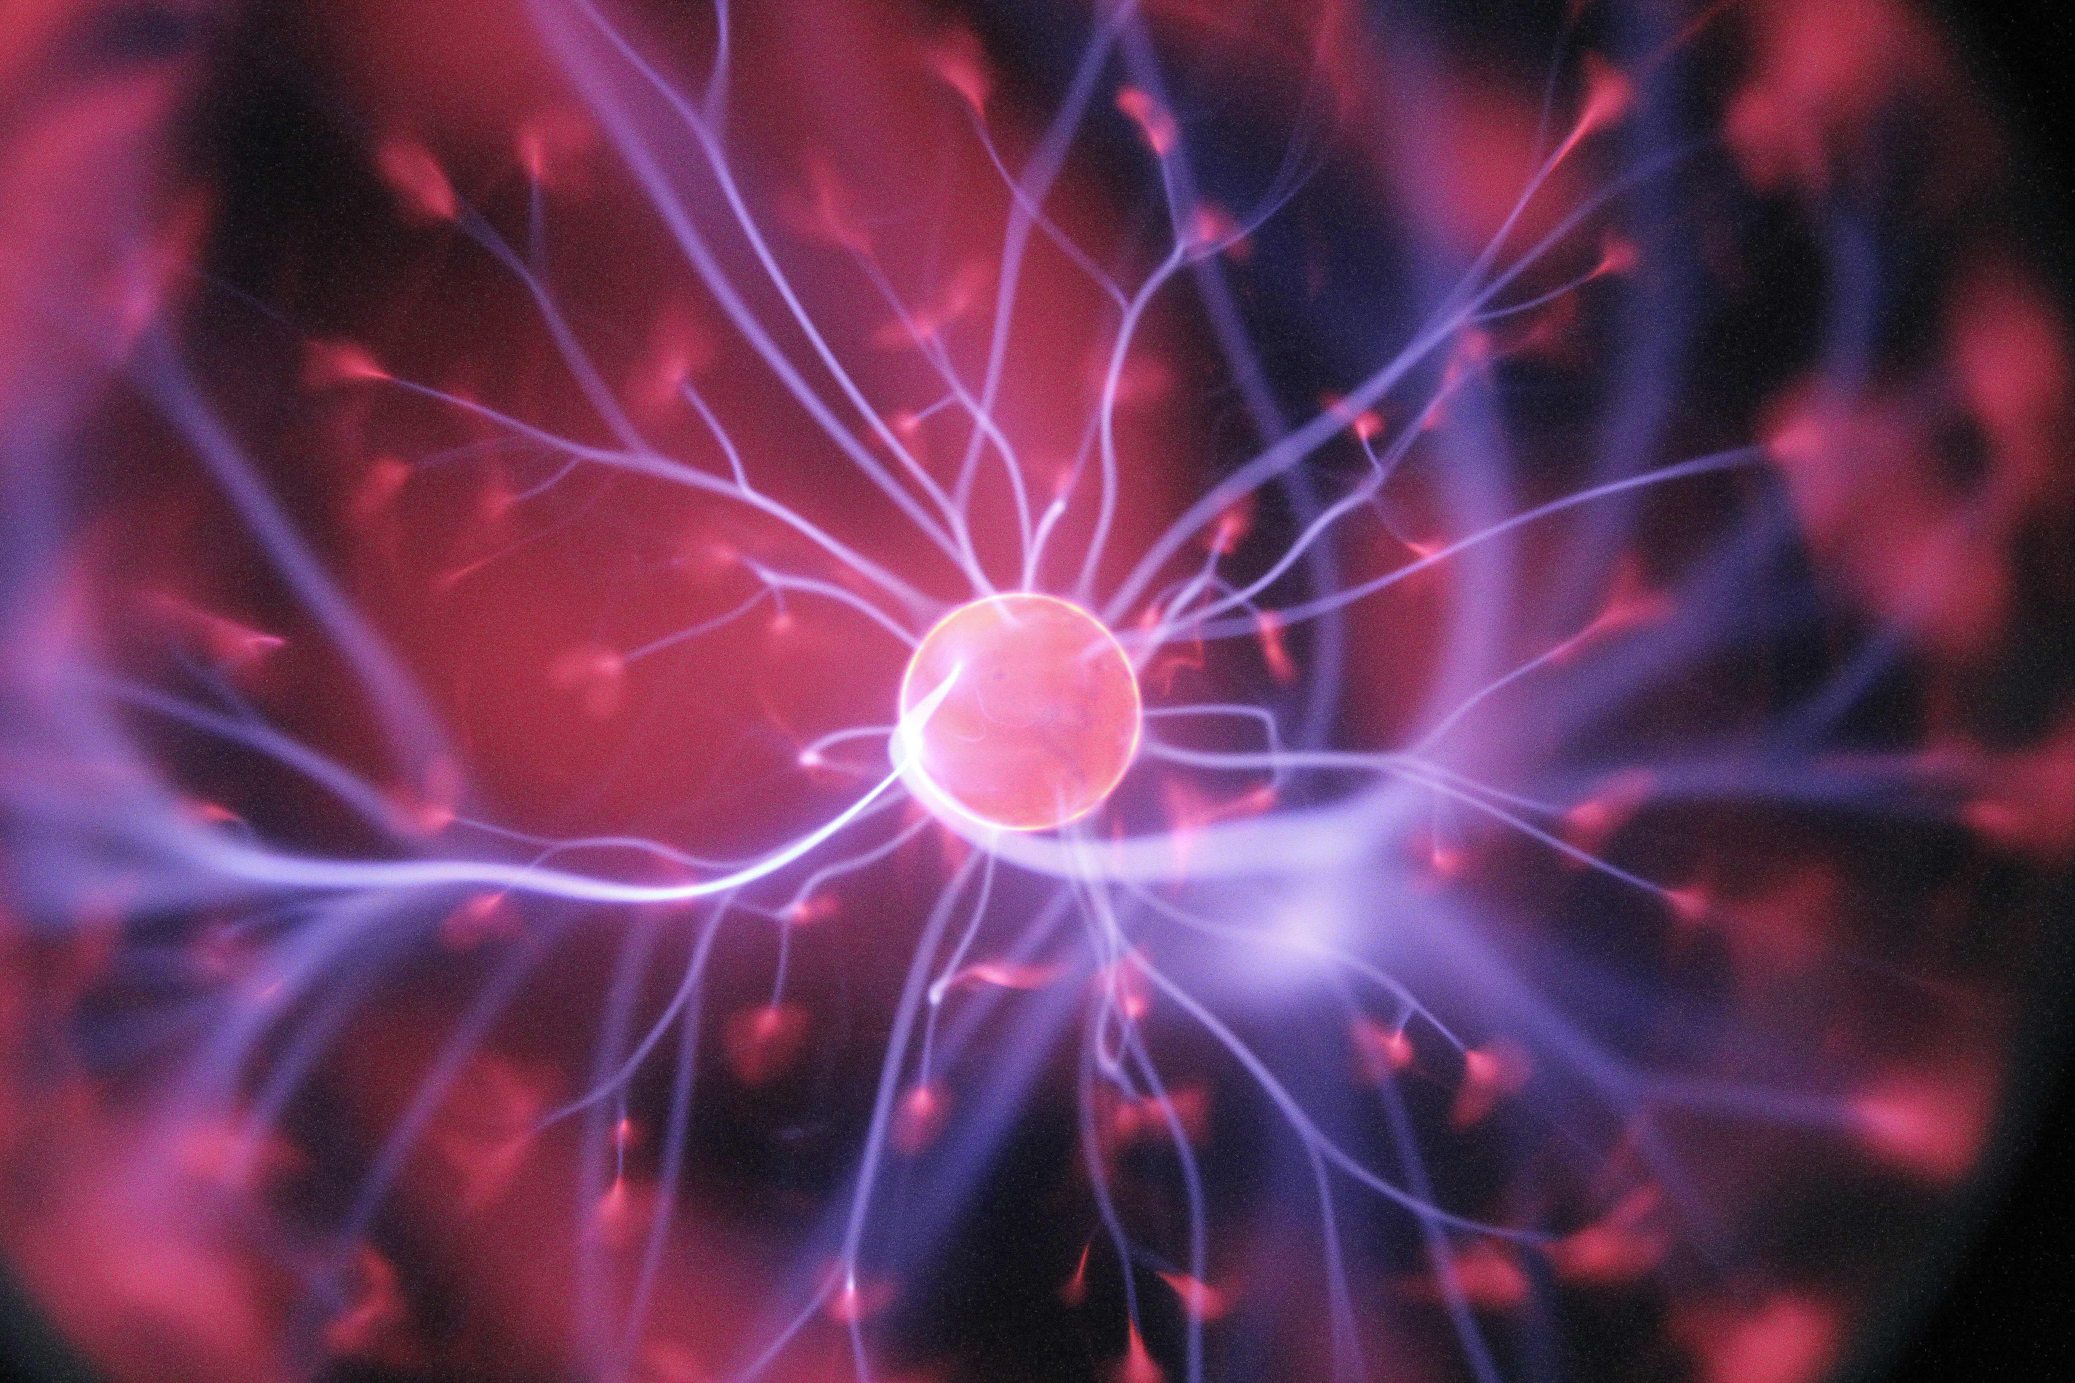
What are Neural Networks?
O1

Slide 5
Definition
Neural networks, also known as artificial neural networks (ANNs) or simulated neural networks (SNNs), are a subset of machine learning and are at the heart of deep learning algorithms. Their name and structure are inspired by the human brain, mimicking the way that biological neurons signal to one another.

Slide 6
. . .
Artificial neural networks (ANNs) are comprised of a node layers, containing an input layer, one or more hidden layers, and an output layer.
Each node, or artificial neuron, connects to another and has an associated weight and threshold. If the output of any individual node is above the specified threshold value, that node is activated, sending data to the next layer of the network. Otherwise, no data is passed along to the next layer of the network.

Slide 7
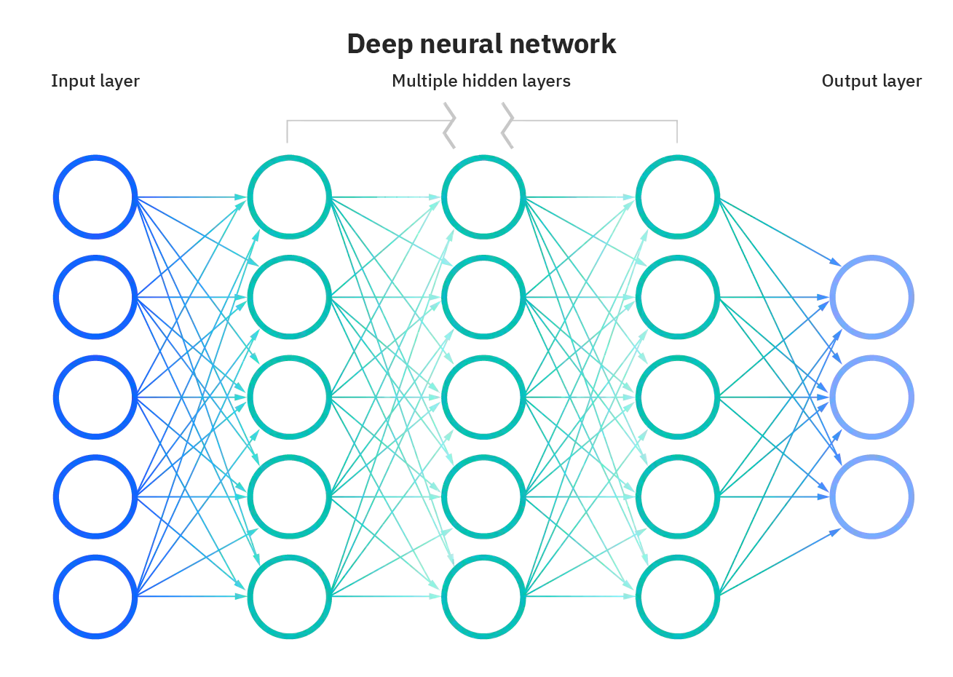

Slide 8
Neural networks rely on training data to learn and improve their accuracy over time. However, once these learning algorithms are fine-tuned for accuracy, they are powerful tools in computer science and artificial intelligence, allowing us to classify and cluster data at a high velocity.
Tasks in speech recognition or image recognition can take minutes versus hours when compared to the manual identification by human experts. One of the most well-known neural networks is Google’s search (in engine) algorithm.

Slide 9
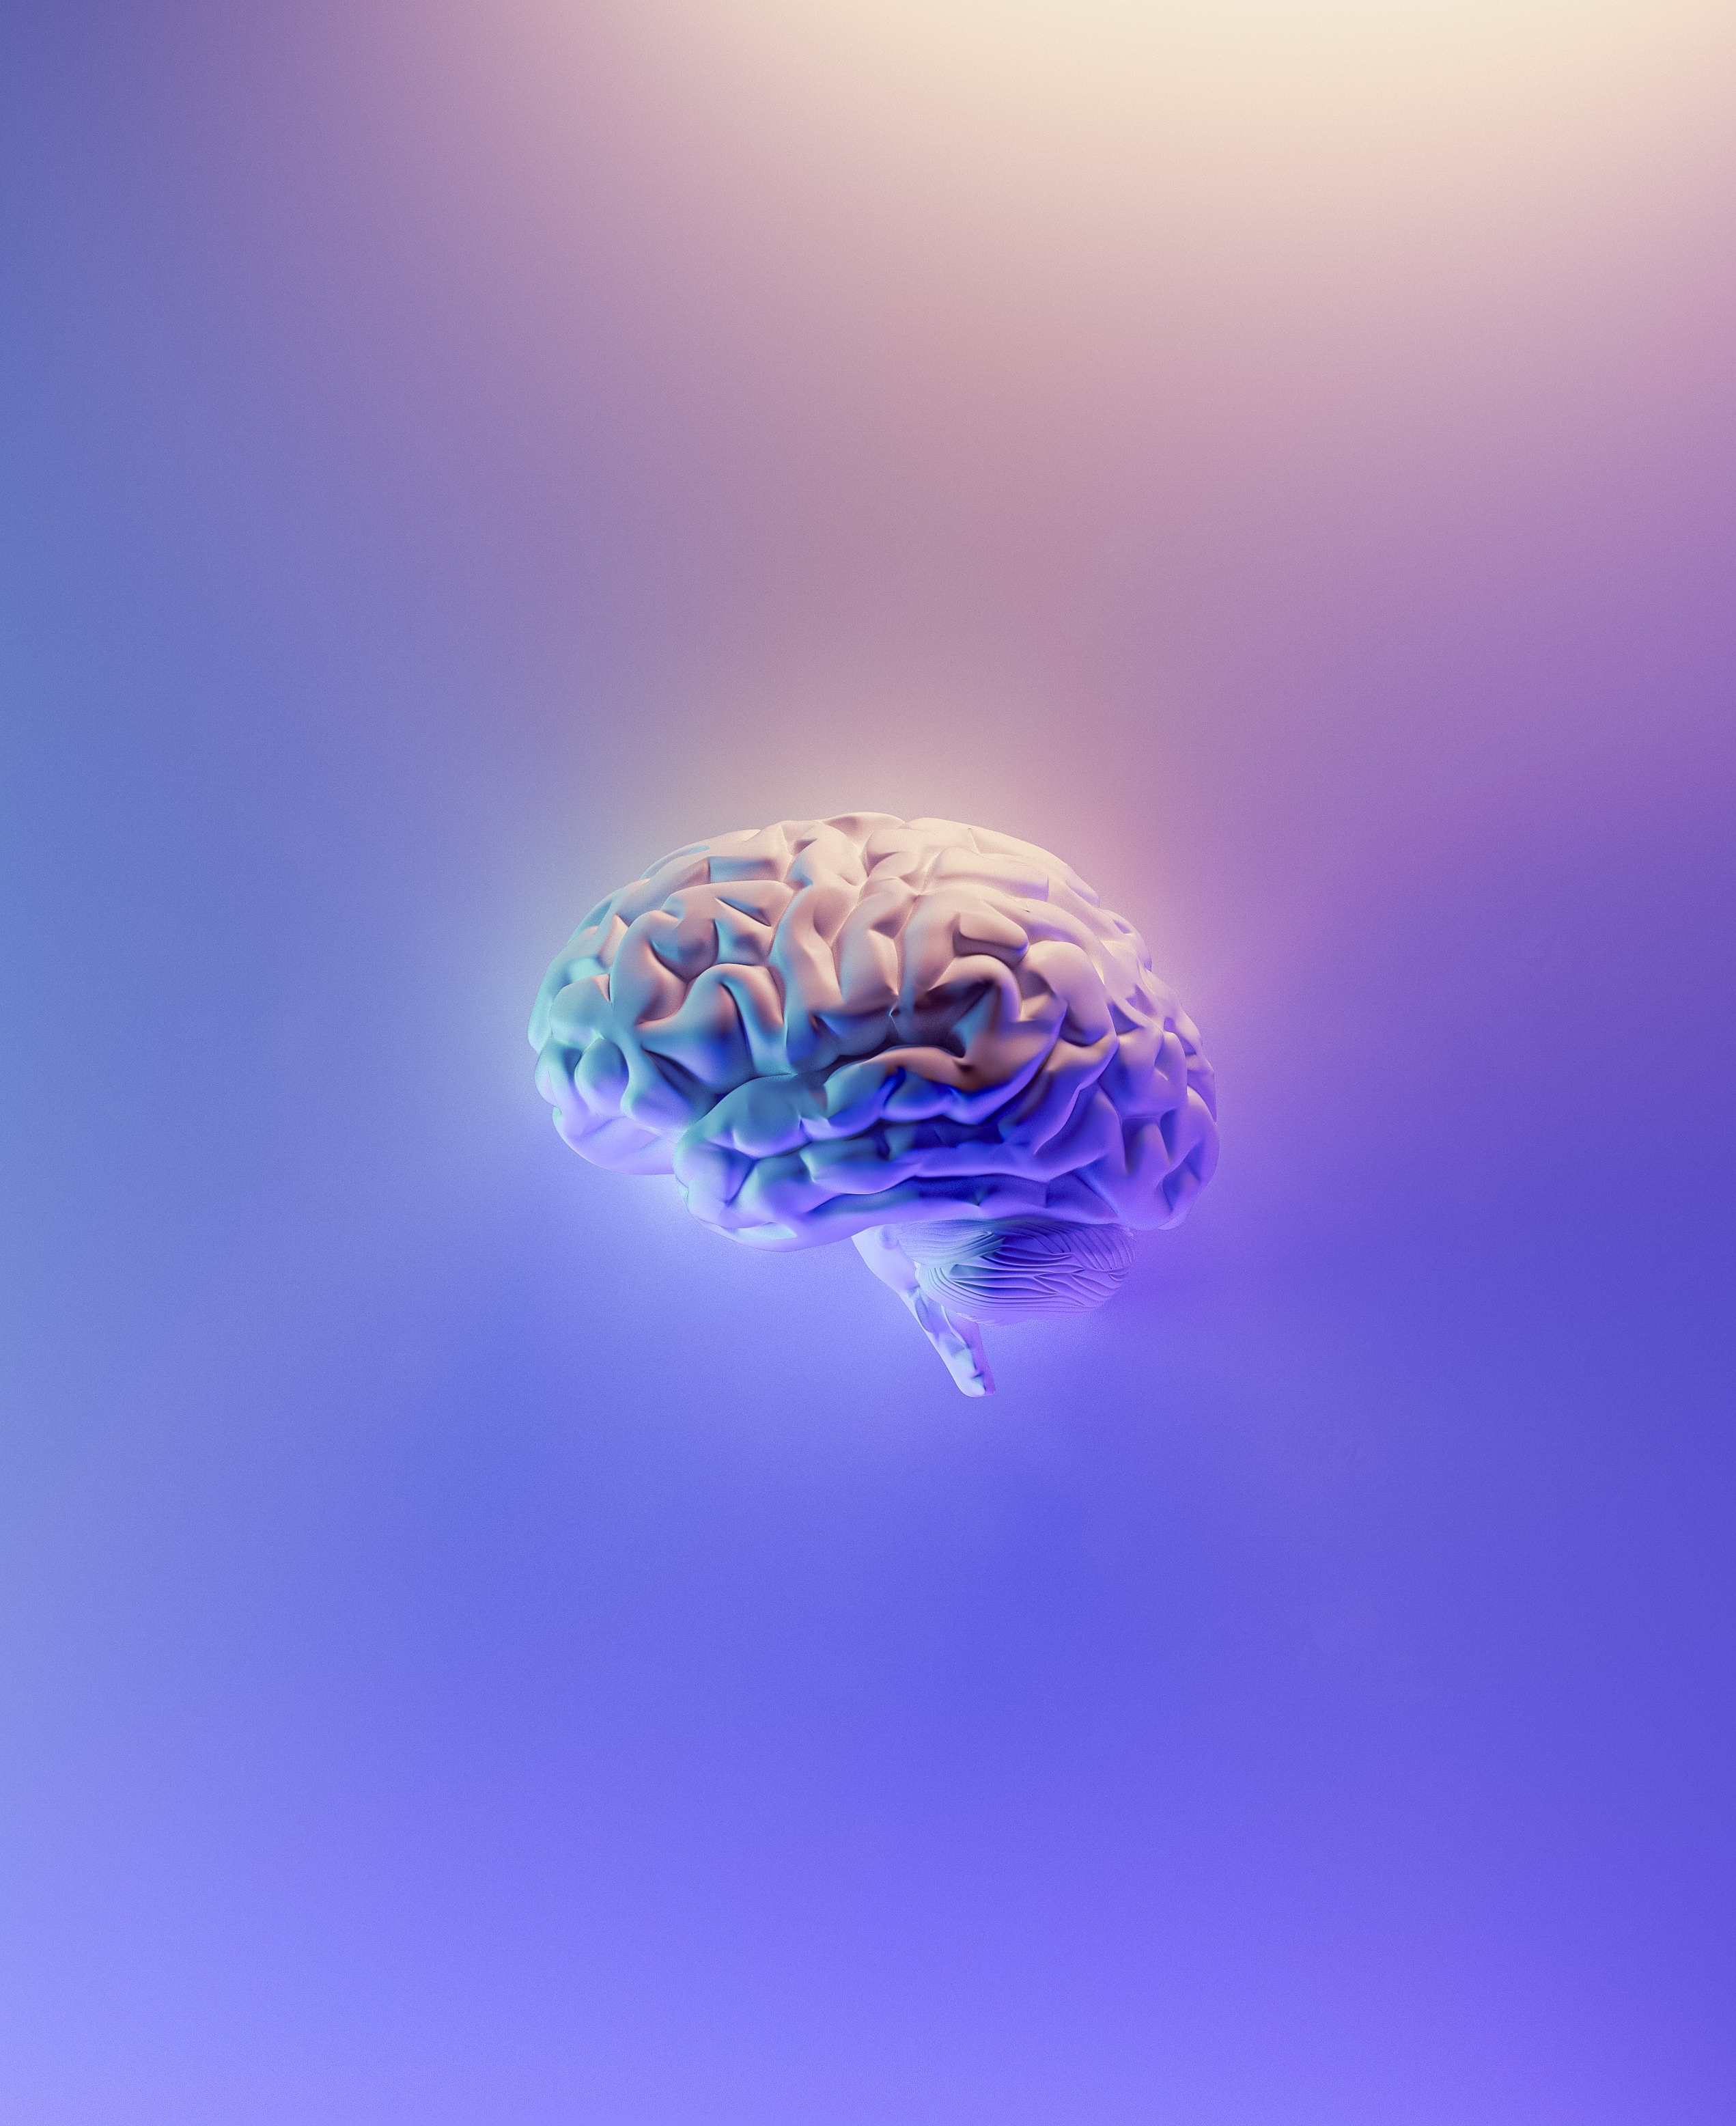
How do Neural Networks work?
O2

Slide 10
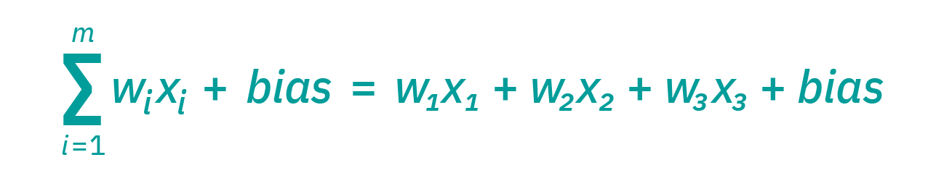
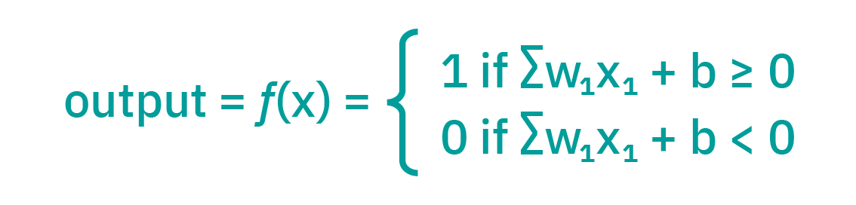
Think of each individual node as its own linear regression model, composed of input data, weights, a bias (or threshold), and an output. The formula would look something like this:
∑wixi + bias = w1x1 + w2x2 + w3x3 + bias
output = f(x) = 1 if ∑w1x1 + b>= 0; 0 if ∑w1x1 + b < 0

Slide 11
Once an input layer is determined, weights are assigned. These weights help determine the importance of any given variable, with larger ones contributing more significantly to the output compared to other inputs.
All inputs are then multiplied by their respective weights and then summed. Afterward, the output is passed through an activation function, which determines the output. If that output exceeds a given threshold, it “fires” (or activates) the node, passing data to the next layer in the network.
This results in the output of one node becoming in the input of the next node. This process of passing data from one layer to the next layer defines this neural network as a feedforward network.

Slide 12
Let’s break down what one single node might look like using binary values. We can apply this concept to a more tangible example, like whether you should go surfing (Yes: 1, No: 0). The decision to go or not to go is our predicted outcome, or y-hat. Let’s assume that there are three factors influencing your decision-making:
Are the waves good? (Yes: 1, No: 0)
Is the line-up empty? (Yes: 1, No: 0)
Has there been a recent shark attack? (Yes: 0, No: 1)
Then, let’s assume the following, giving us the following inputs:
X1 = 1, since the waves are pumping
X2 = 0, since the crowds are out
X3 = 1, since there hasn’t been a recent shark attack

Slide 13
Now, we need to assign some weights to determine importance. Larger weights signify that particular variables are of greater importance to the decision or outcome.
W1 = 5, since large swells don’t come around often
W2 = 2, since you’re used to the crowds
W3 = 4, since you have a fear of sharks
Finally, we’ll also assume a threshold value of 3, which would translate to a bias value of –3. With all the various inputs, we can start to plug in values into the formula to get the desired output.
Y-hat = (1*5) + (0*2) + (1*4) – 3 = 6

Slide 14
If we use the activation function from the beginning of this section, we can determine that the output of this node would be 1, since 6 is greater than 0. In this instance, you would go surfing; but if we adjust the weights or the threshold, we can achieve different outcomes from the model. When we observe one decision, like in the above example, we can see how a neural network could make increasingly complex decisions depending on the output of previous decisions or layers.
In the example above, we used perceptrons to illustrate some of the mathematics at play here, but neural networks leverage sigmoid neurons, which are distinguished by having values between 0 and 1. Since neural networks behave similarly to decision trees, cascading data from one node to another, having x values between 0 and 1 will reduce the impact of any given change of a single variable on the output of any given node, and subsequently, the output of the neural network.

Slide 15
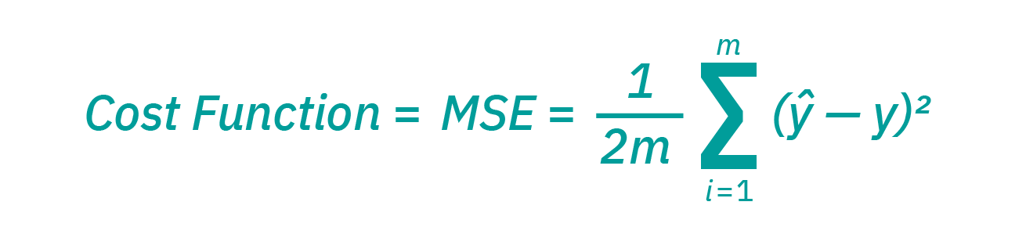
As we start to think about more practical use cases for neural networks, like image recognition or classification, we’ll leverage supervised learning, or labeled datasets, to train the algorithm. As we train the model, we’ll want to evaluate its accuracy using a cost (or loss) function. This is also commonly referred to as the mean squared error (MSE). In the equation below,
i represents the index of the sample,
y-hat is the predicted outcome,
y is the actual value, and
m is the number of samples.

Slide 16
Ultimately, the goal is to minimize our cost function to ensure correctness of fit for any given observation. As the model adjusts its weights and bias, it uses the cost function and reinforcement learning (trajectory optimization, motion planning, dynamic pathing, controller optimization, and scenario-based learning policies for highways) to reach the point of convergence, or the local minimum. The process in which the algorithm adjusts its weights is through gradient descent, allowing the model to determine the direction to take to reduce errors (or minimize the cost function). With each training example, the parameters of the model adjust to gradually converge at the minimum.
Most deep neural networks are feedforward, meaning they flow in one direction only, from input to output. However, you can also train your model through backpropagation; that is, move in the opposite direction from output to input. Backpropagation allows us to calculate and attribute the error associated with each neuron, allowing us to adjust and fit the parameters of the model(s) appropriately.

Slide 17
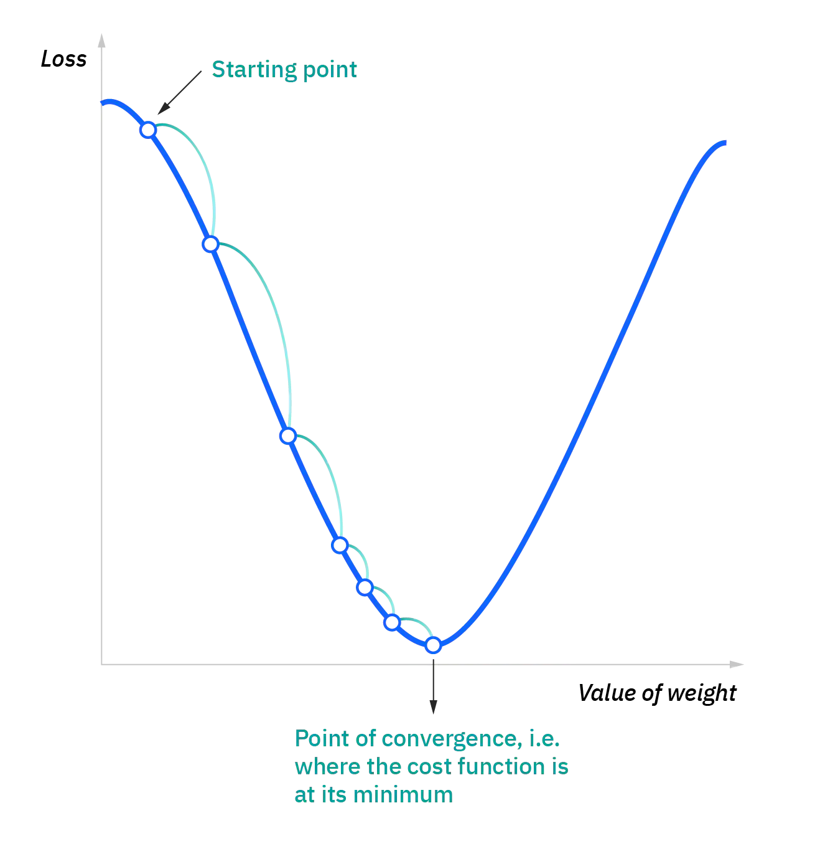

Slide 18
Types of Neural Networks
O3

Slide 19
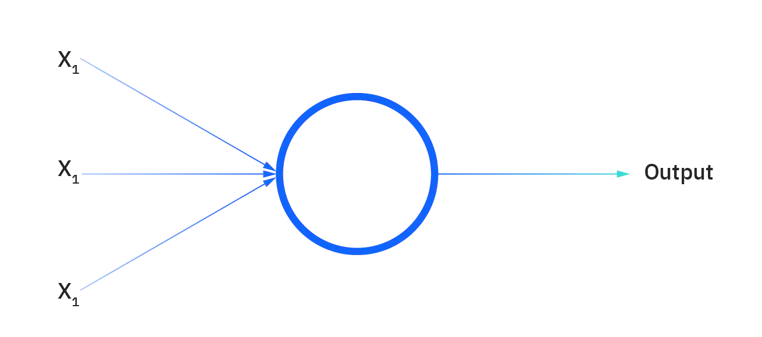
Neural networks can be classified into different types, which are used for different purposes. While this isn’t a comprehensive list of types, the below would be representative of the most common types of neural networks that you’ll come across for its common use cases:
The perceptron is the oldest neural network, created by Frank Rosenblatt in 1958. It has a single neuron and is the simplest form of a neural network:

Slide 20
Feedforward neural networks, or multi-layer perceptrons (MLPs), are what we’ve primarily been focusing on within this presentation. They are comprised of an input layer, a hidden layer or layers, and an output layer. While these neural networks are also commonly referred to as MLPs, it’s important to note that they are actually comprised of sigmoid neurons, not perceptrons, as most real-world problems are nonlinear. Data usually is fed into these models to train them, and they are the foundation for computer vision, natural language processing, and other neural networks.
Convolutional neural networks (CNNs) are similar to feedforward networks, but they’re usually utilized for image recognition, pattern recognition, and/or computer vision. These networks harness principles from linear algebra, particularly matrix multiplication, to identify patterns within an image.
Recurrent neural networks (RNNs) are identified by their feedback loops. These learning algorithms are primarily leveraged when using time-series data to make predictions about future outcomes, such as stock market predictions or sales forecasting.

Slide 21
NN vs. Deep Learning
O4

Slide 22
Comparison
Deep Learning and neural networks tend to be used interchangeably in conversation, which can be confusing. As a result, it’s worth nothing that the “deep” in deep learning is just referring to the depth of layers in a neural network.
A neural network that consists of more than three layers — which would be inclusive of the inputs and the output — can be considered a deep learning algorithm. A neural network that only has two or three layers is just a basic neural network.

Slide 23

History of NN & Applications
O5

Slide 24
The history of neural networks is longer than most people think. While the idea of “a machine that thinks” can be traced to the Ancient Greeks, we’ll focus on the key events that led to the evolution of thinking around neural networks, which has ebbed and flowed in popularity over the years…

Slide 25

Pros & Cons of usages of NN
O6

Slide 26
Advantages of Artificial Neural Networks
Parallel Processing
Resistency
ANN can handle more than one task at a time
Loss one neuron influences whole process in network
Consistency
Self Thought
In absence of input data pair NN still generates the result
We are able to train ANN’s that these networks learn from past events and make decisions.

Slide 27
Disadvantages of Artificial Neural Networks
Expensive ( heavy ) Processing
Unpredictable Network Structure
ANN’s hard to compute, because of parallel processing feature
It’s hard to build or predict a proper NN structure at the very first try
No alternative solution
Non-explainary Solutions
Most of the problems can be solve by NN may also be solved by statistical models
It means even you get the perfect solution you wouldn’t know how NN got the answer (anonymous processing)

Slide 28
Application of NN
Autonomous cars
Speech Recognition
Face Detection
Object Recognition
Natural Language Processing (NLP)

Slide 29
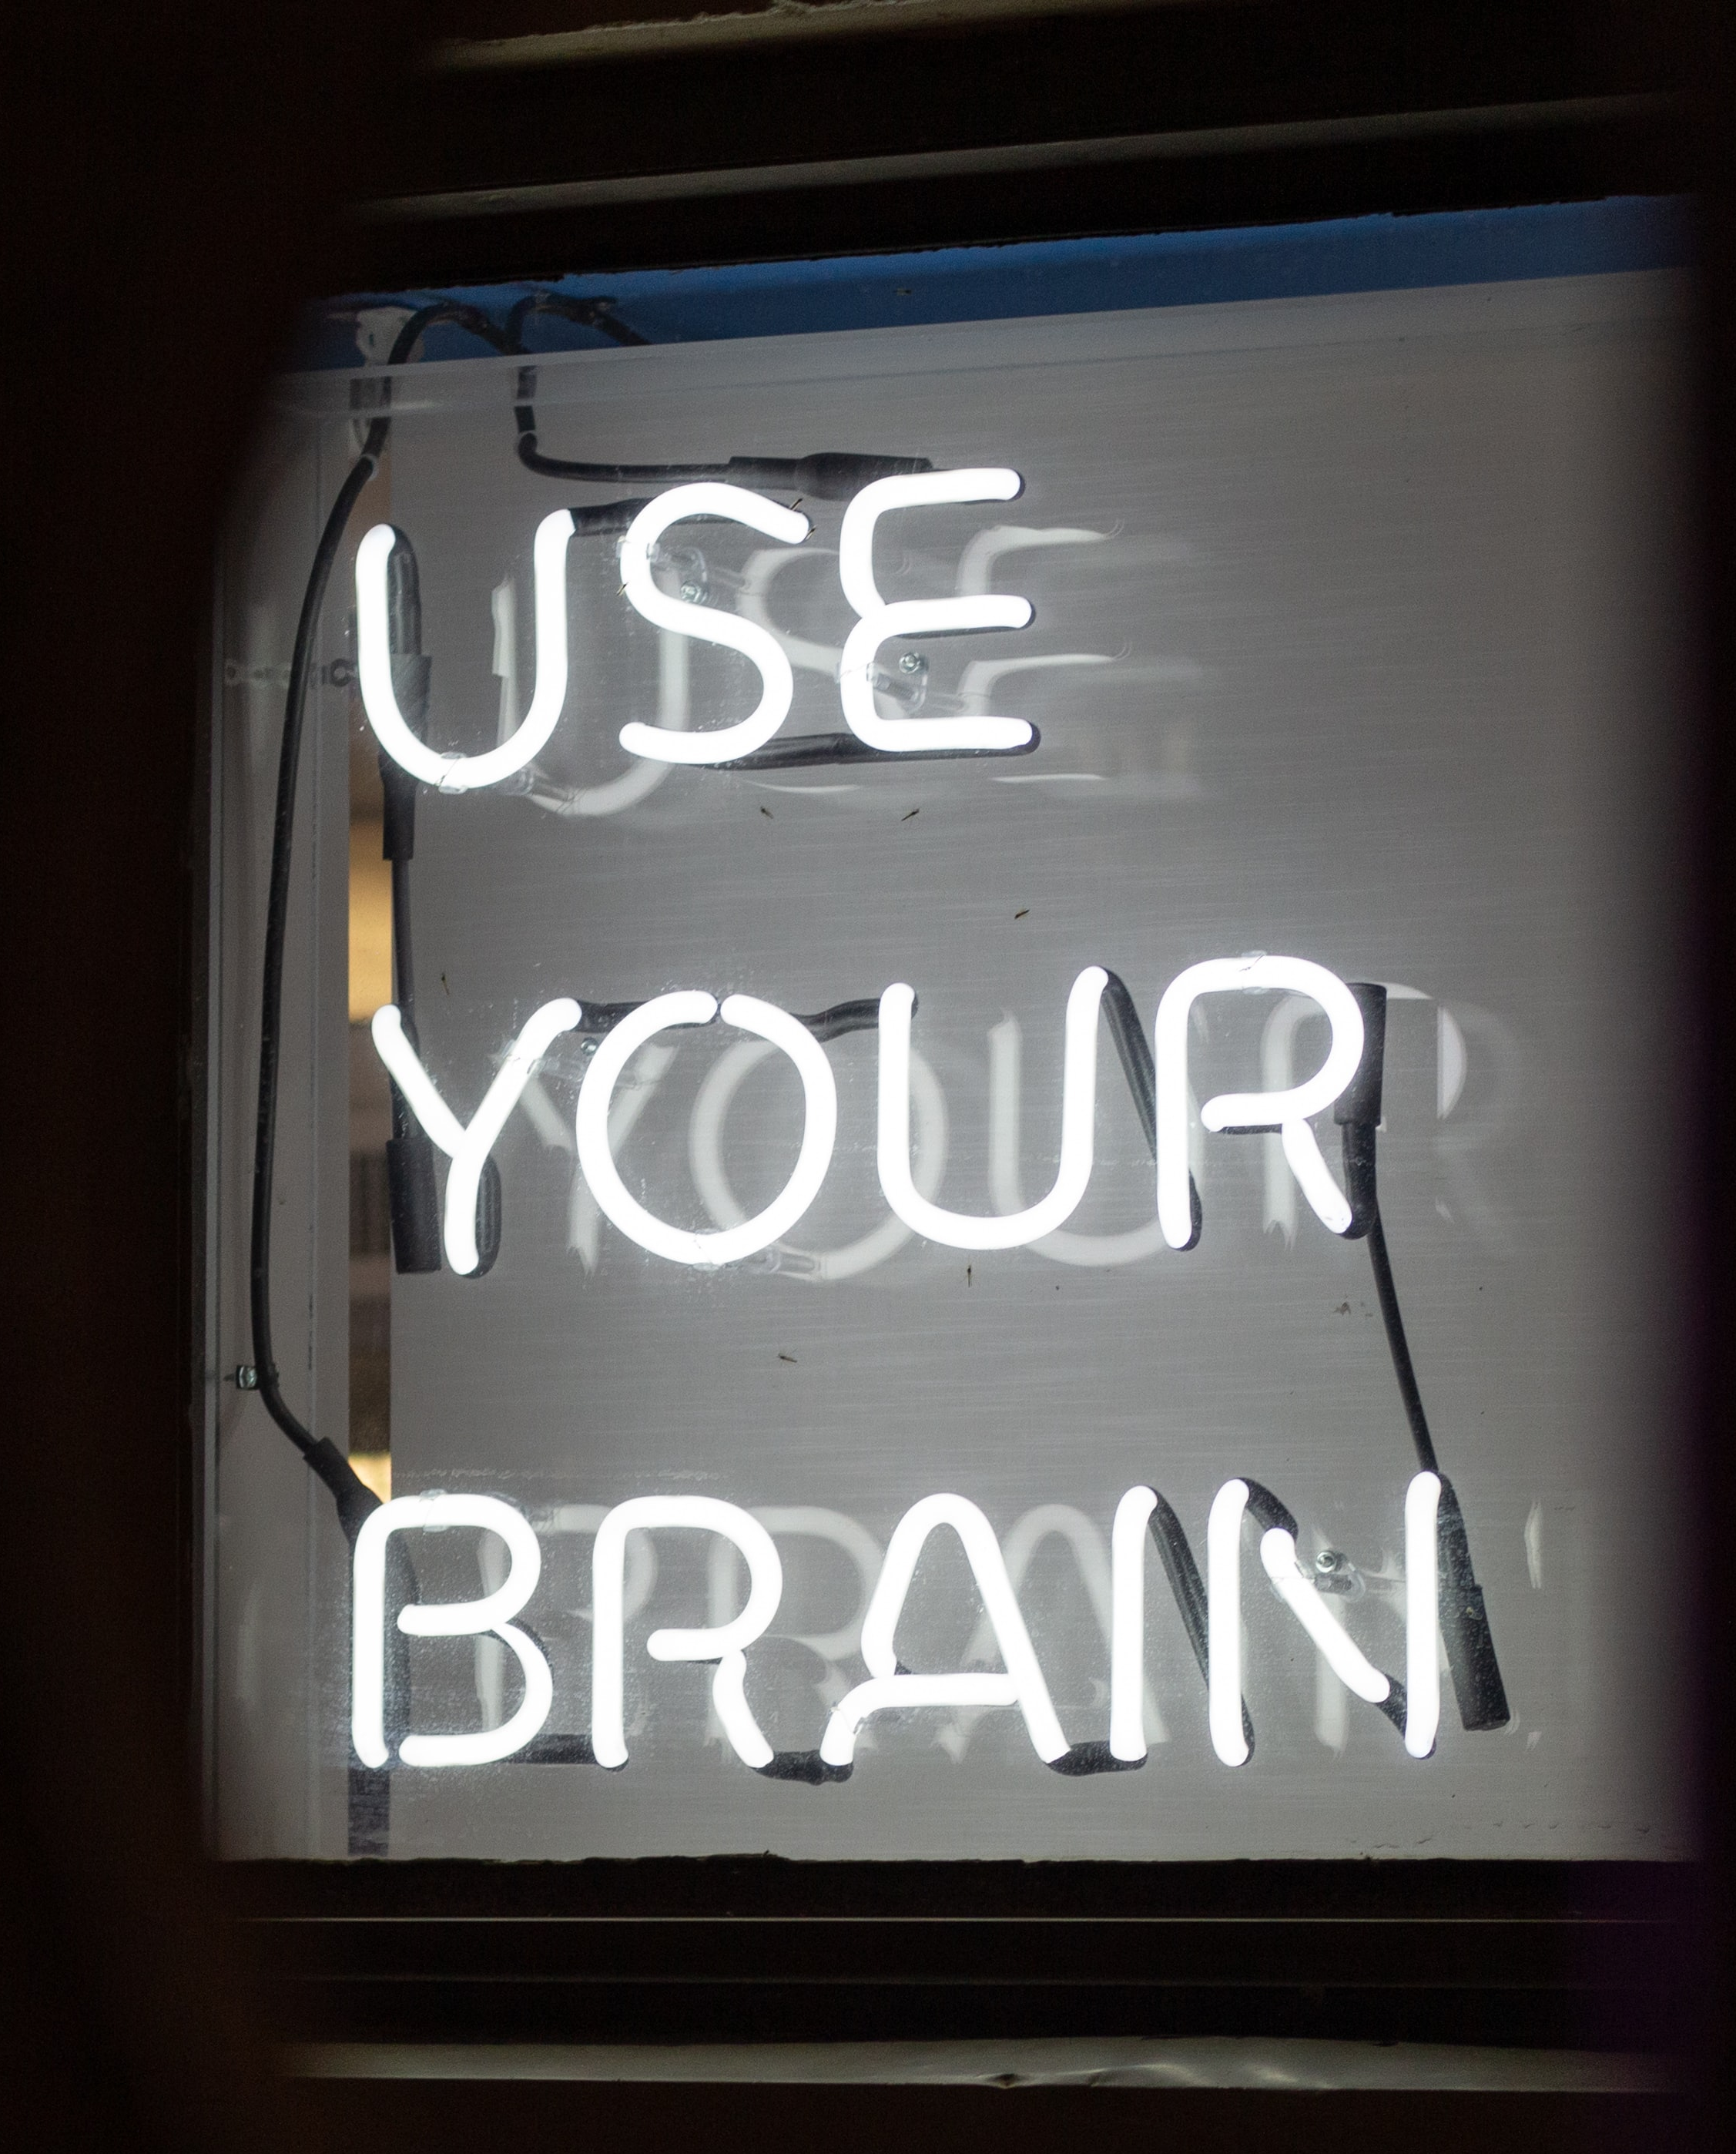
THANKS
THANKS
for your attention and time to took for the speech!
Nuran Tarlan | nuran.terlan@mail.ru

